Slide 1
IBM Advanced Data Science Capstone Project COVID-19 Predictions

Slide 2
COVID-19?
In COVID-19,
'CO' stands for 'corona‘
'VI' for 'virus’
and 'D' for disease
Formerly, this disease was referred to as “2019 novel coronavirus” or “2019-nCoV”, This Started in Wuhan, China.
Coronaviruses are members of the coronavirus family of viruses — one of the many families that include viruses able to infect people and animals. Seven members of the coronavirus family can make people ill, one of which is the new coronavirus strain SARS-CoV-2, which causes COVID-19.

Slide 3
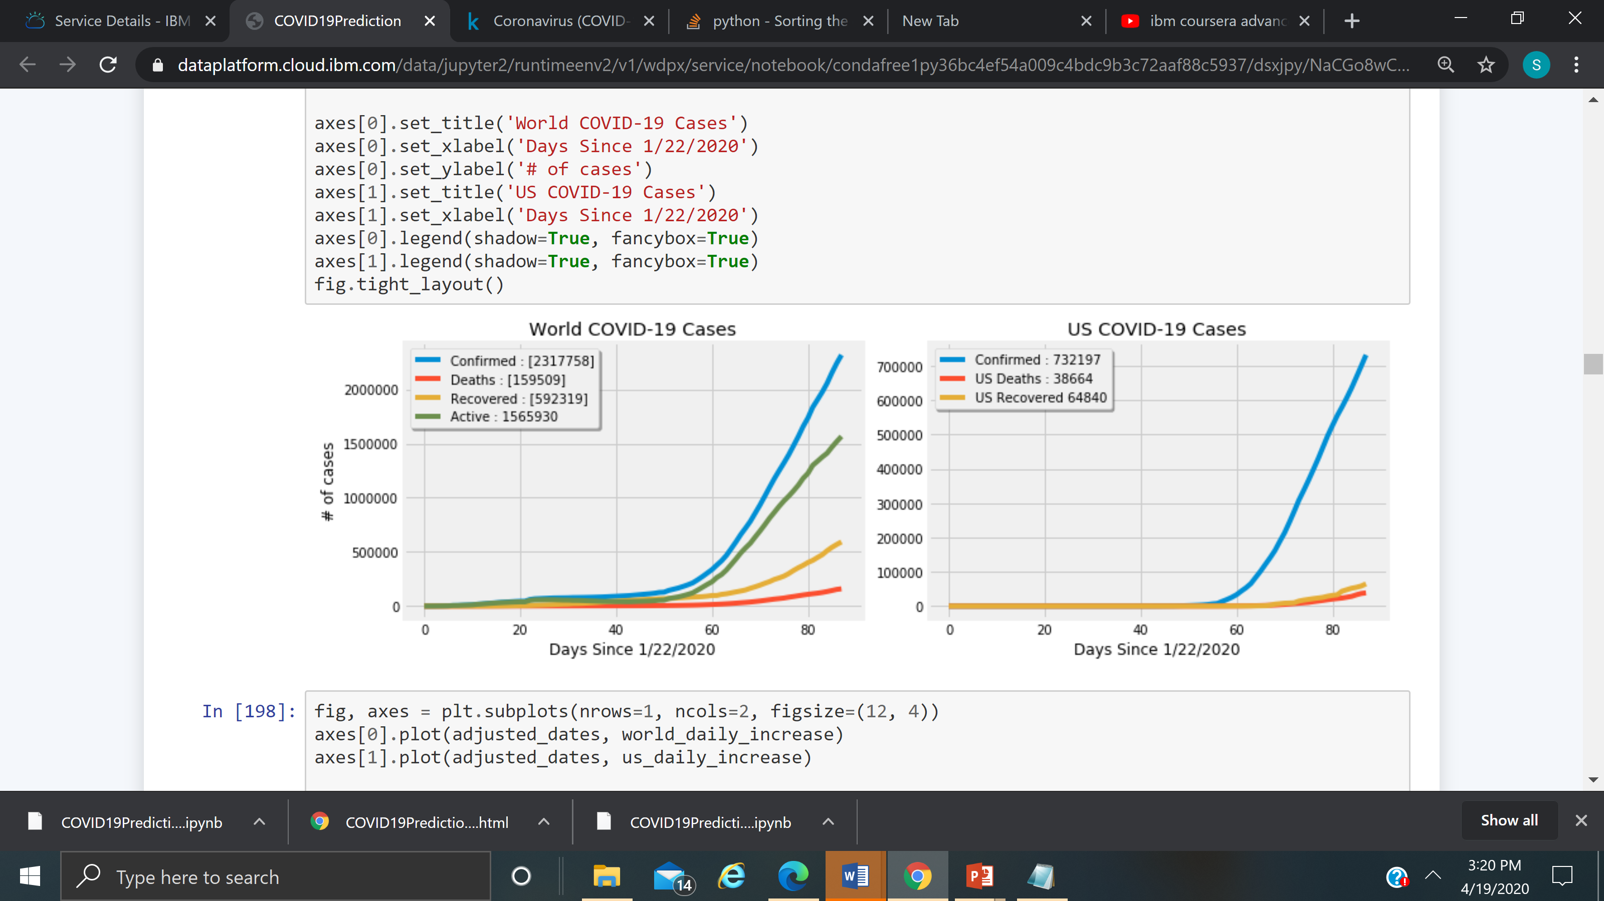
COVID-19 Predictions : Cases by World, US

Slide 4
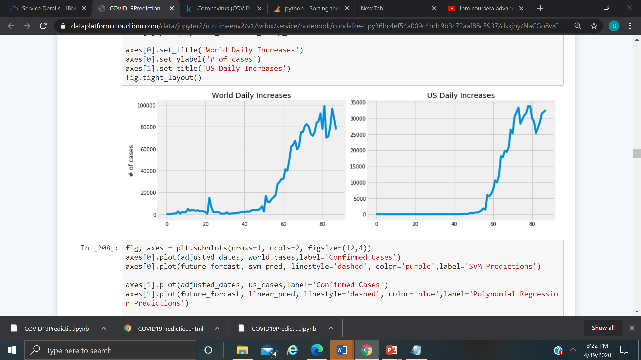
COVID-19 Predictions : Daily Increase Cases by Days

Slide 5
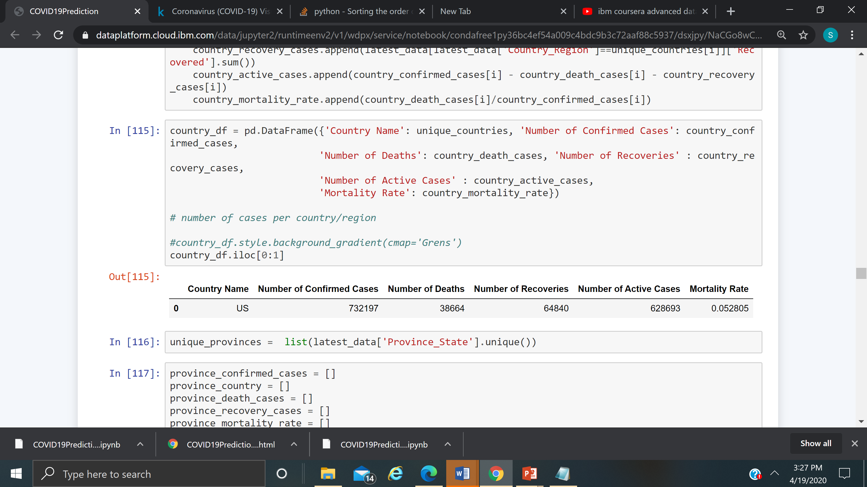
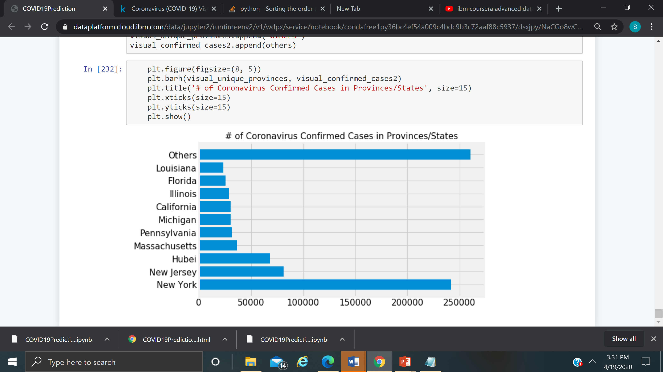
COVID-19 Predictions : US cases in the top

Slide 6
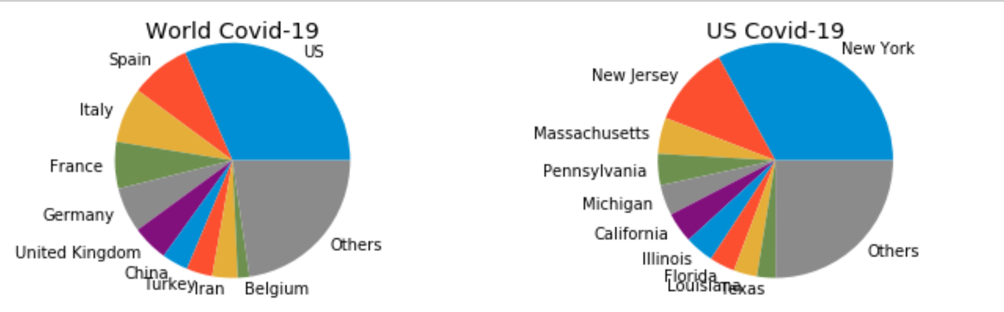
COVID-19 Predictions : Chart by top 10 World, US

Slide 7
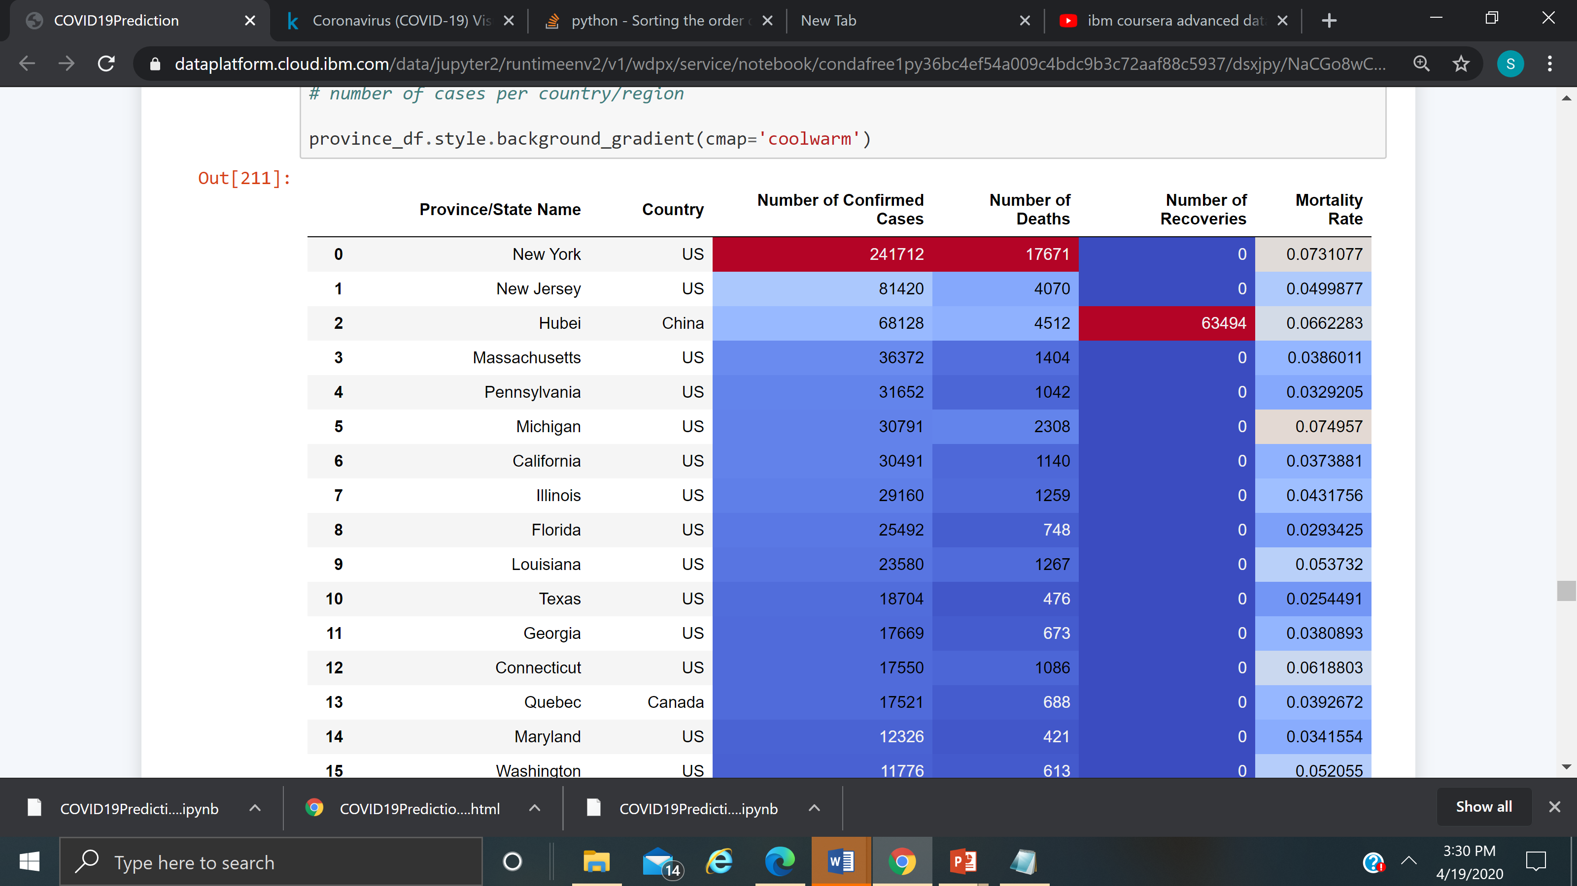
COVID-19 Predictions : Data by Province/State

Slide 8
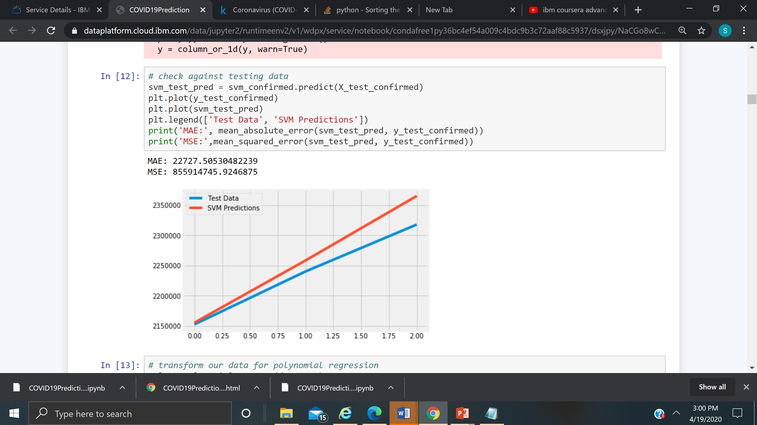
COVID-19 Predictions : SVM In machine learning, support-vector machines are supervised learning models with associated learning algorithms that analyze data used for classification and regression analysis.

Slide 9
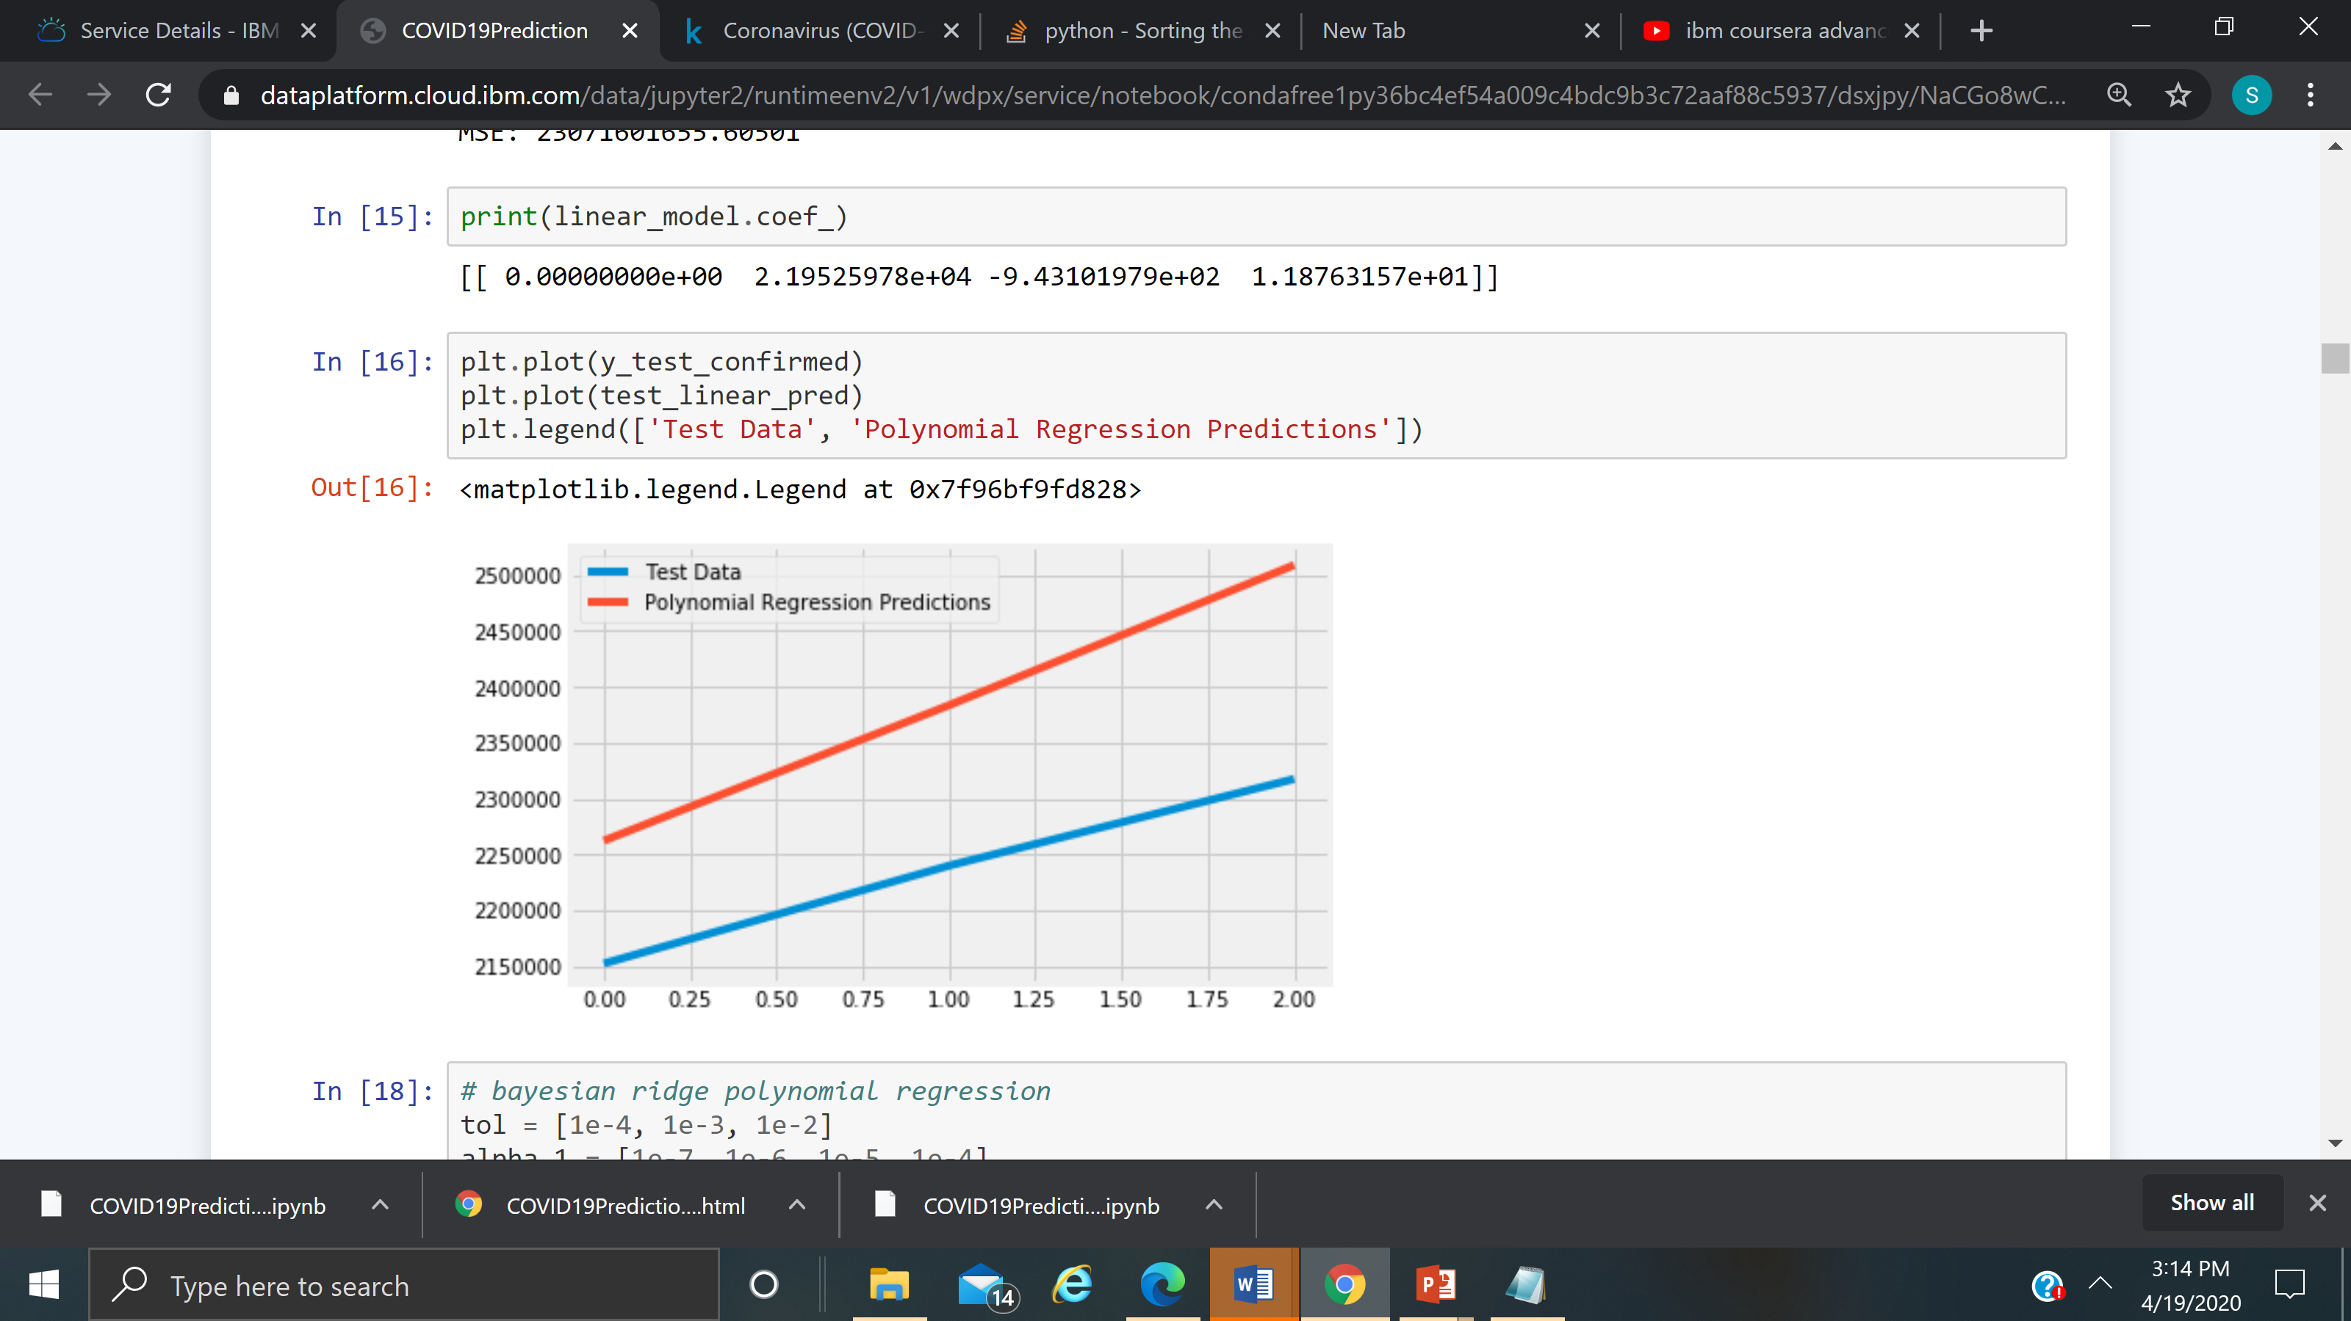
COVID-19 Predictions : Polynomial Regression original features are converted into Polynomial features of required degree (2,3,..,n) and then modeled using a linear model."
MAE: 148174.50781263752 MSE: 23071601655.60501
MAE: 148174.50781263752
MSE: 23071601655.60501

Slide 10
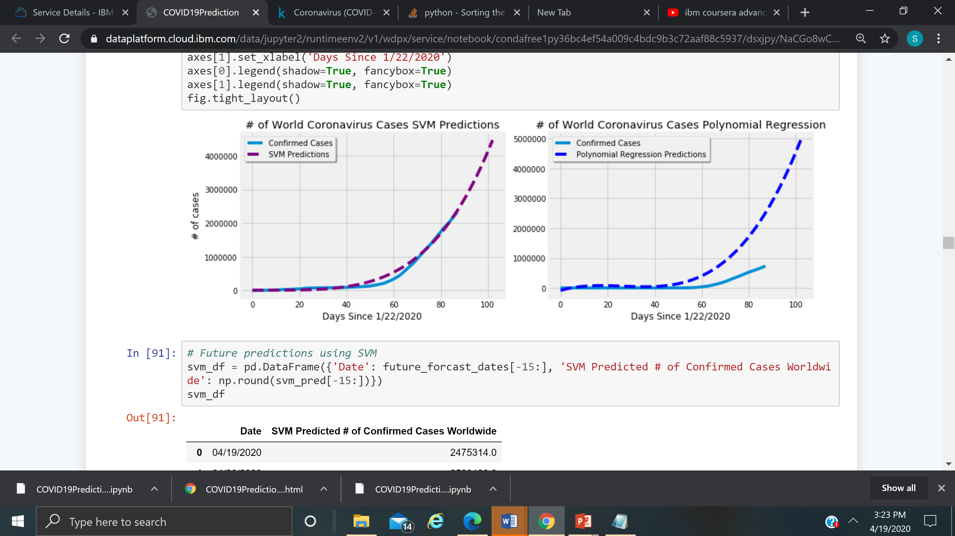
COVID-19 Predictions : SVM vs Polynomial Regression

Slide 11
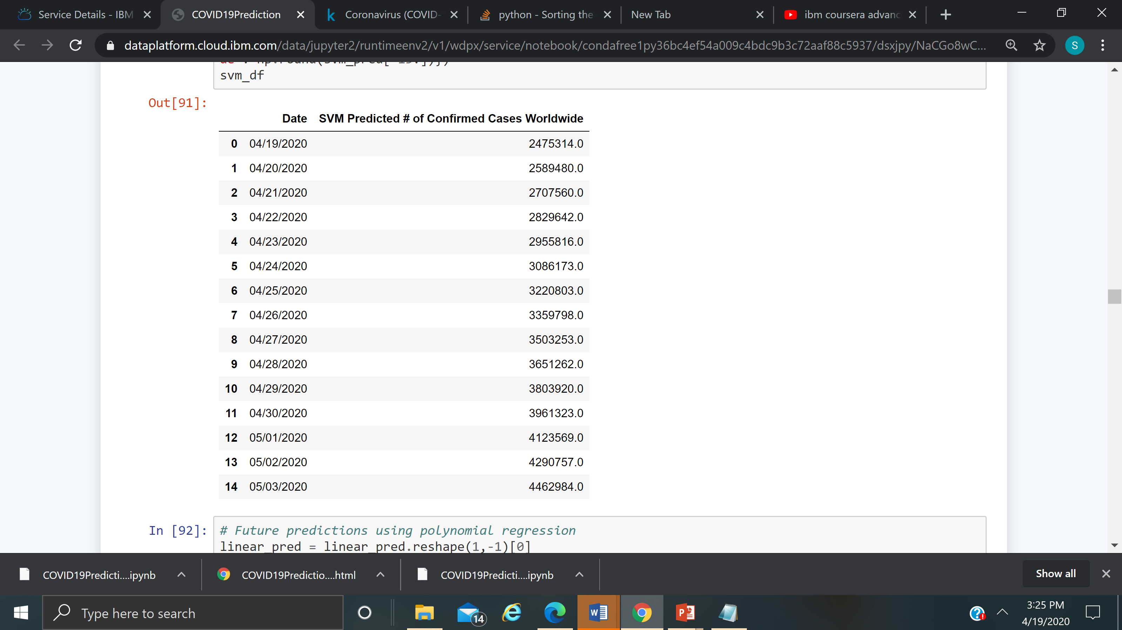
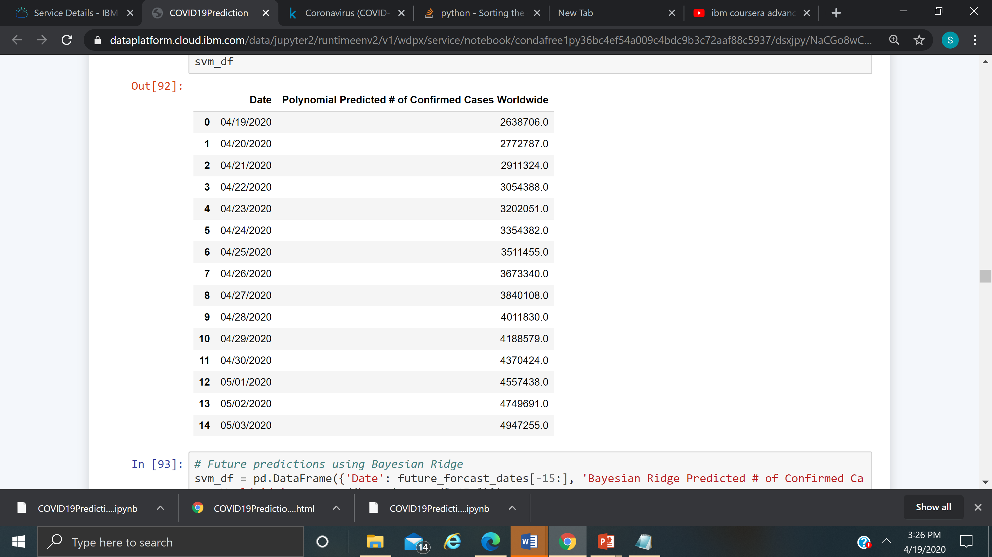
COVID-19 Predictions : SVM vs Polynomial by day

Slide 12
Prevention : Protect yourself and others around you by knowing the facts and taking appropriate precautions. Follow advice provided by your local public health agency.
Protect yourself and others around you by knowing the facts and taking appropriate precautions. Follow advice provided by your local public health agency.
To prevent the spread of COVID-19:
Clean your hands often. Use soap and water, or an alcohol-based hand rub.
Maintain a safe distance from anyone who is coughing or sneezing.
Don’t touch your eyes, nose or mouth.
Cover your nose and mouth with your bent elbow or a tissue when you cough or sneeze.
Stay home if you feel unwell.
If you have a fever, a cough, and difficulty breathing, seek medical attention. Call in advance.
Follow the directions of your local health authority.
Avoiding unneeded visits to medical facilities allows healthcare systems to operate more effectively, therefore protecting you and others.

Slide 13
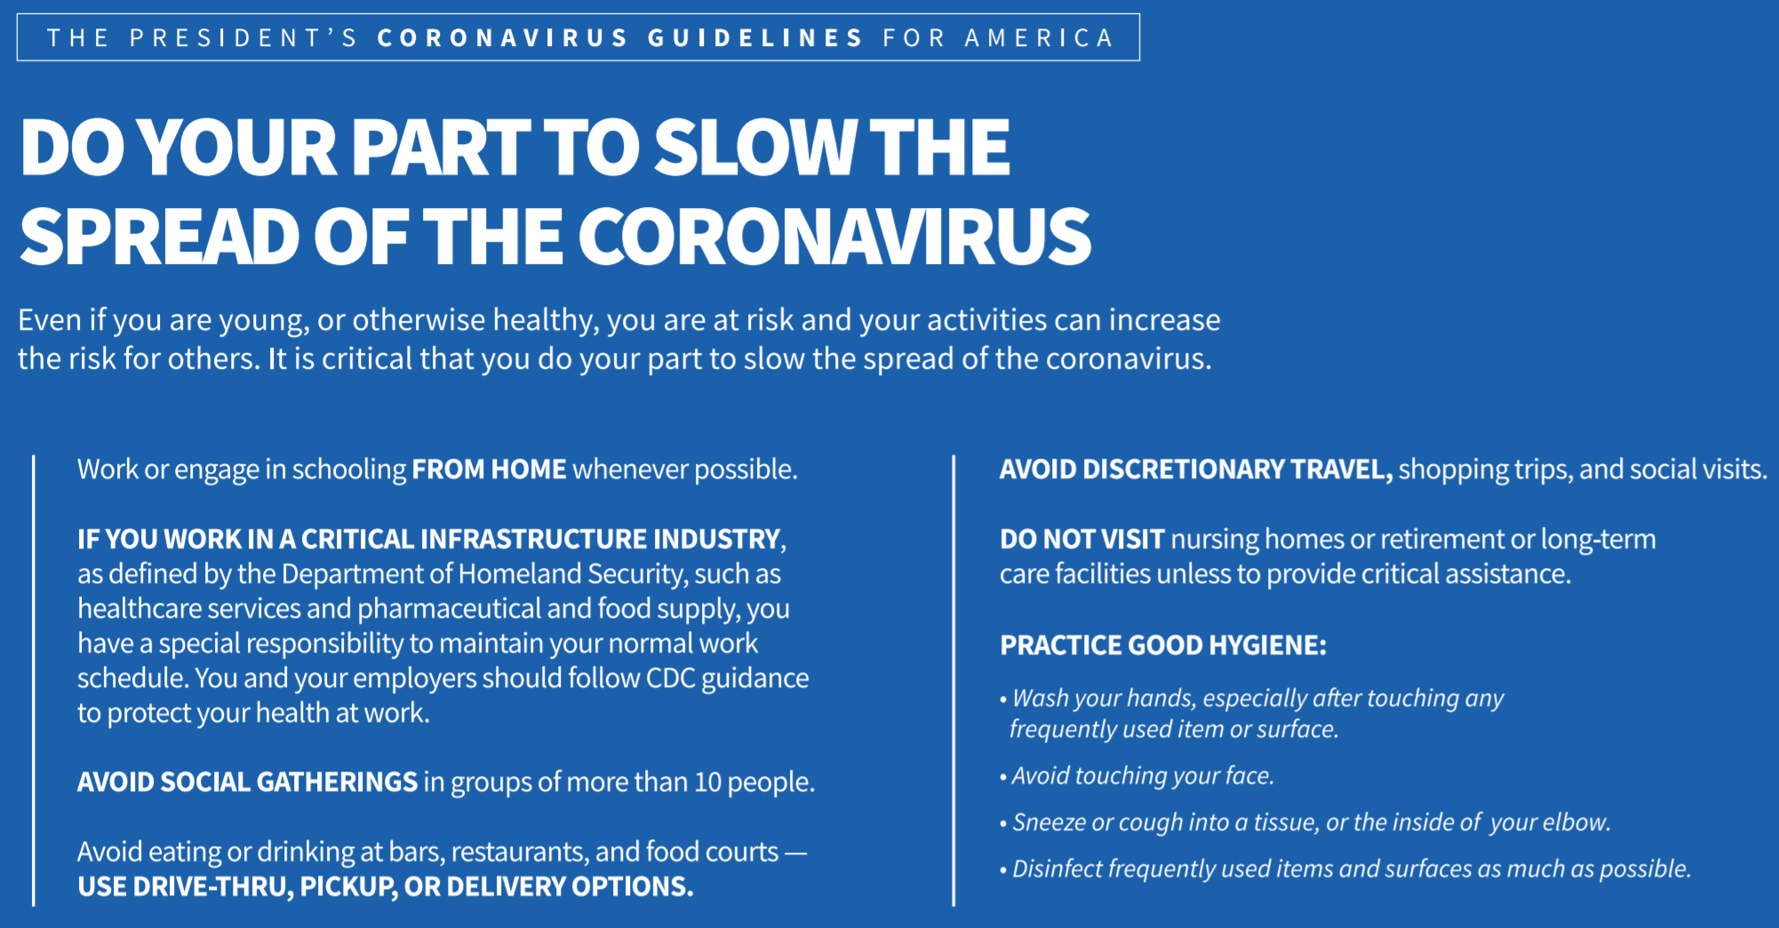

Slide 14
Acknowledgements
I would like to acknowledge Johns Hopkins University for open-sourcing their dataset. Their dataset is transformed into a format that is easier for IBM Watson Jupyter notebook to handle.
I would like to thank my instructor Romeo Kienzler for teaching Coursera classes on Advanced Machine Learning.

